Slide 1

Visión por Computador
Domingo Mery
Departmento de Ciencia de la Computación
Escuela de Ingeniería
Universidad Católica de Chile
Facial Analysis

Slide 2
Motivation

Slide 3
What can we say from faces?

Slide 4
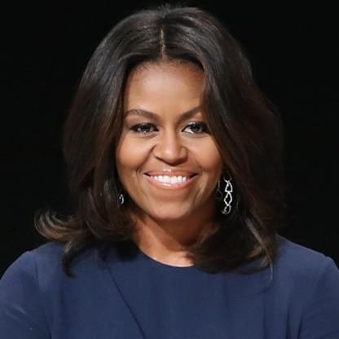
Facial Analysis
In face analysis, the task is to identify a subject appearing in an image as a unique individual and to extract facial attributes like age, gender, and expressions from the face image.
Face detected
Frontal face
Woman
Michell Obama
54 years
Happy

Slide 5
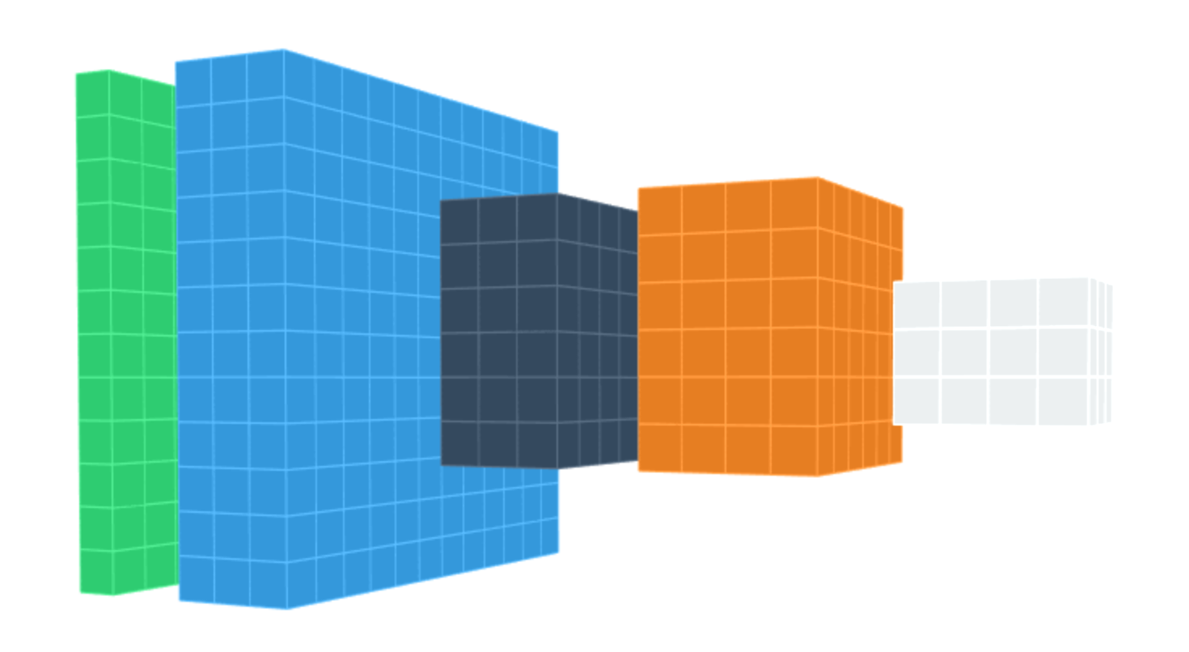
Deep Learning Model
Data representation /
Classification /
Measurement
Input
image
Layers

Slide 6
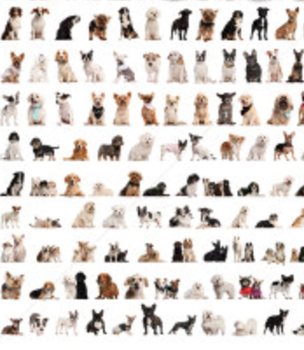
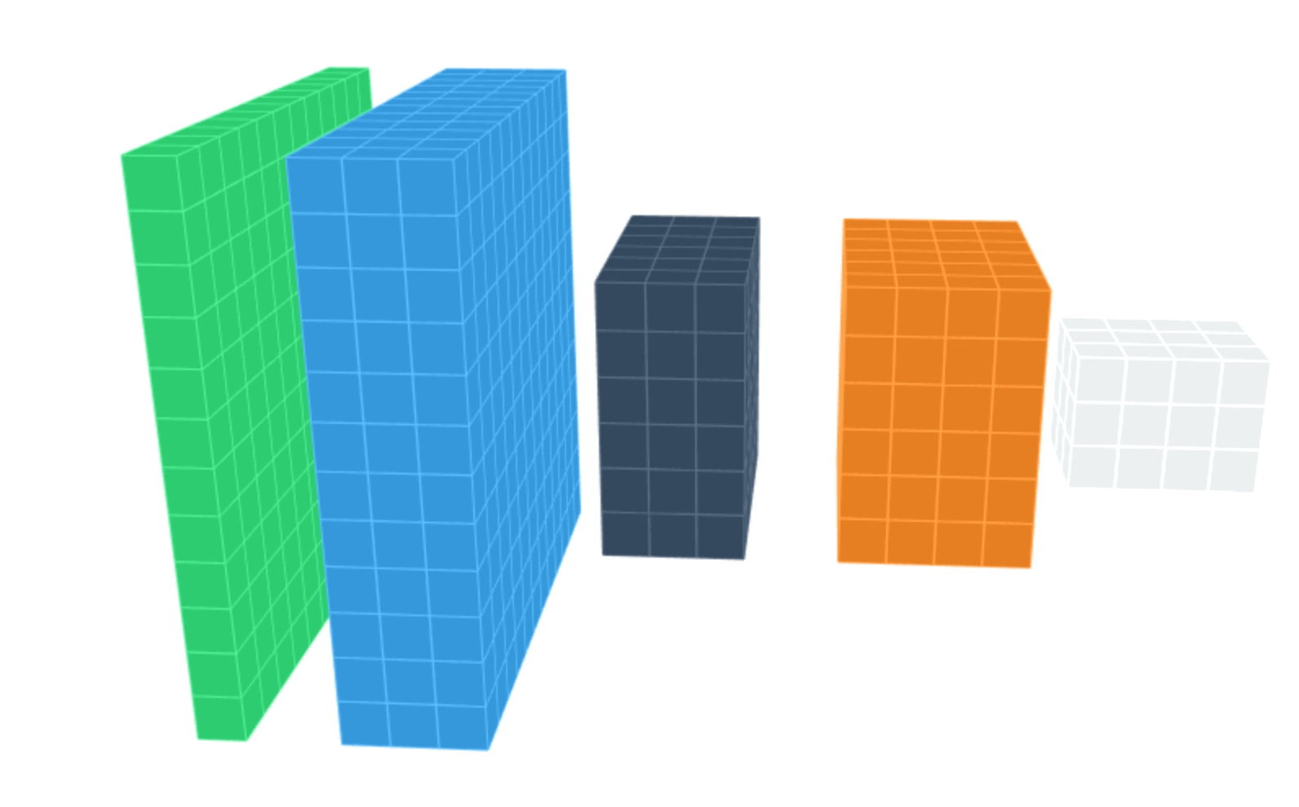


DEEP LEARNING: Training
dogs
errors
cats
Back-propagation

Slide 7
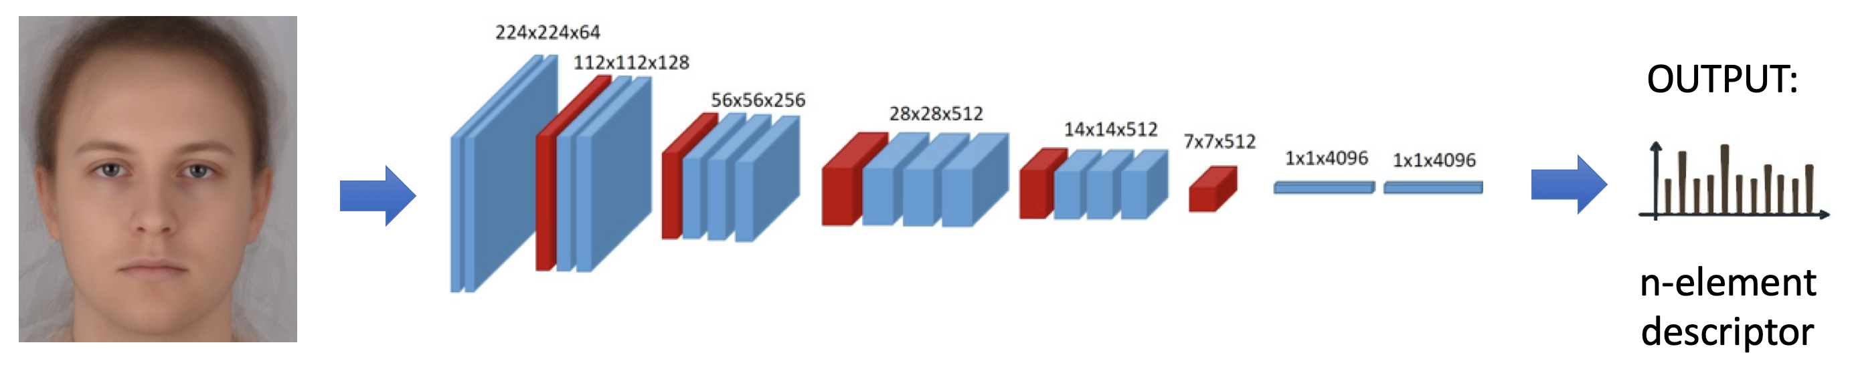
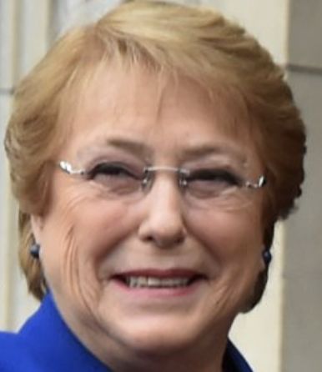
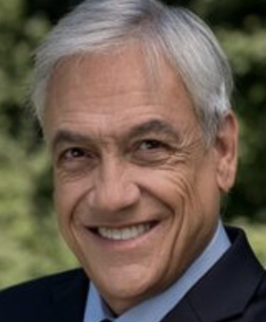
Face Recognition
FR
Faces from same/different subjects have similar/different descriptors
FR
Yes: same
No: different
FR

Slide 8
Facial Expressions
Dataset:
Faces with expressions
7-class problem

Slide 9
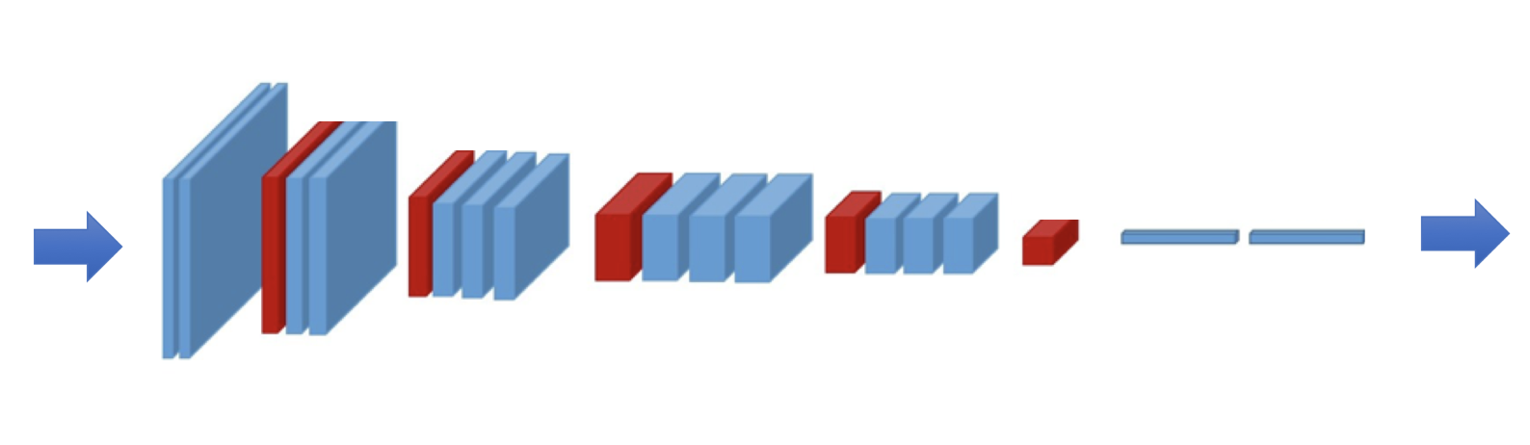
Facial Expressions
Deep Learning Model
Output
7-element
vector
Angry | Disgust | Scared | Happy | Sad | Surprised | Neutral
0.2161 | 0.2403 | 0.0337 | 0.2423 | 0.16780 | 0.0259 | 0.0739

Slide 10
Gender Recognition
Dataset:
Female and Male Faces
2-Class Problem

Slide 11
Gender Recognition
Deep Learning Model
Output
2-element
vector
Male | Female
0.74 | 0.26

Slide 12
Age Recognition
Dataset:
Faces with age
Two approaches:
Output is a class (class 1: from 0 to 2 years, class 1: from 3 to 8, etc)
Output is a scalar (age of the person)

Slide 13
Age Recognition
Deep Learning Model
Output
n-element
Vector or
scalar

Slide 14
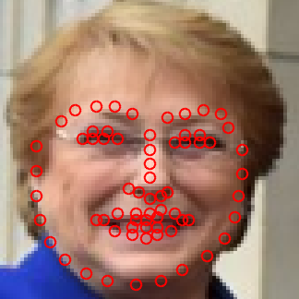
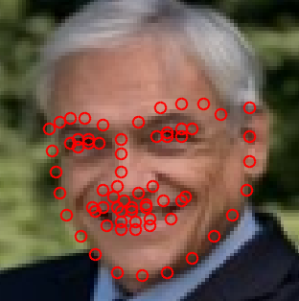
Example
Gender | Age | Angry | Disgust | Scared | Happy | Sad | Surprised | Neutral
0.82 | 58.5 | 0.0174 | 0.0005 | 0.0045 | 0.8540 | 0.0692 | 0.0011 | 0.0532
Gender | Age | Angry | Disgust | Scared | Happy | Sad | Surprised | Neutral
0.04 | 59.9 | 0.0012 | 0.0001 | 0.0014 | 0.9371 | 0.0109 | 0.0001 | 0.0491

Slide 15
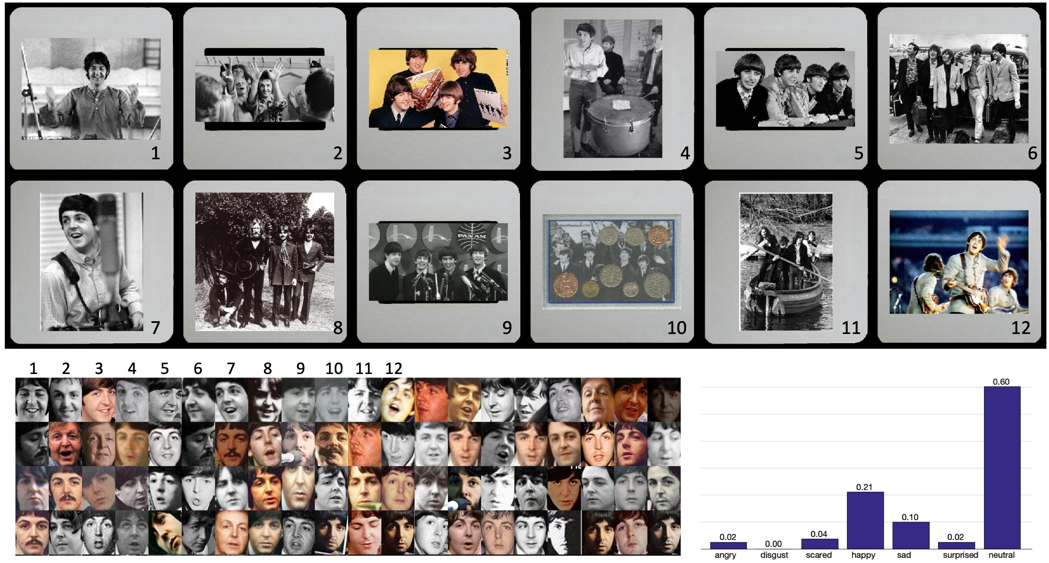
Example

Slide 16
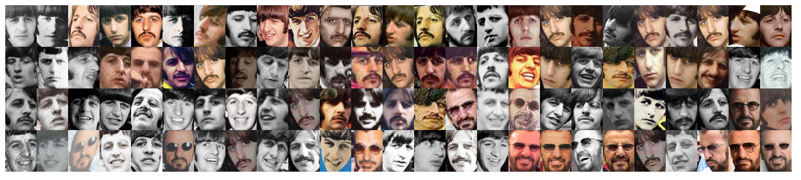
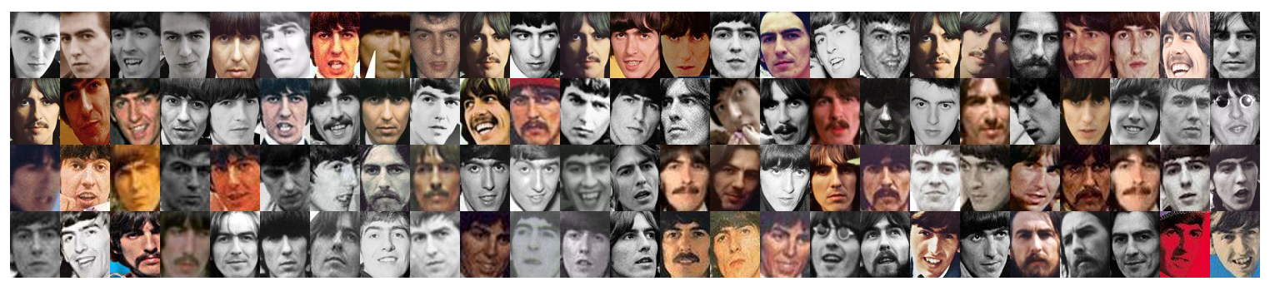
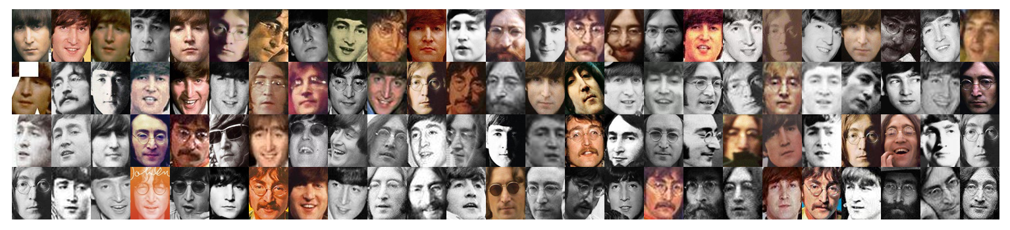
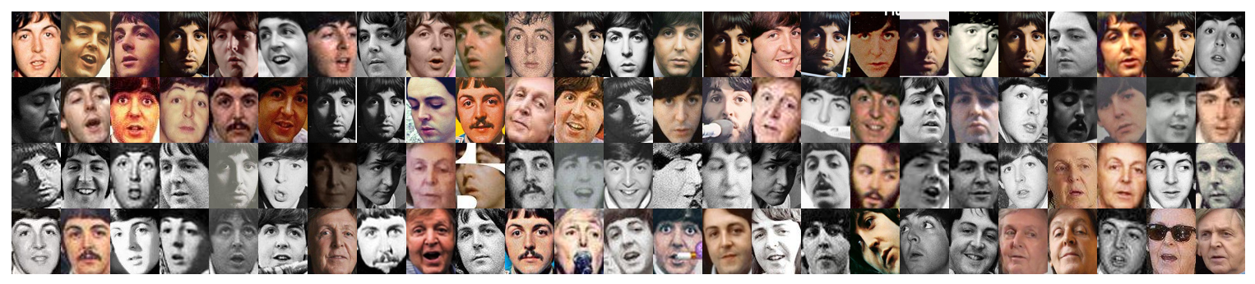

Slide 17
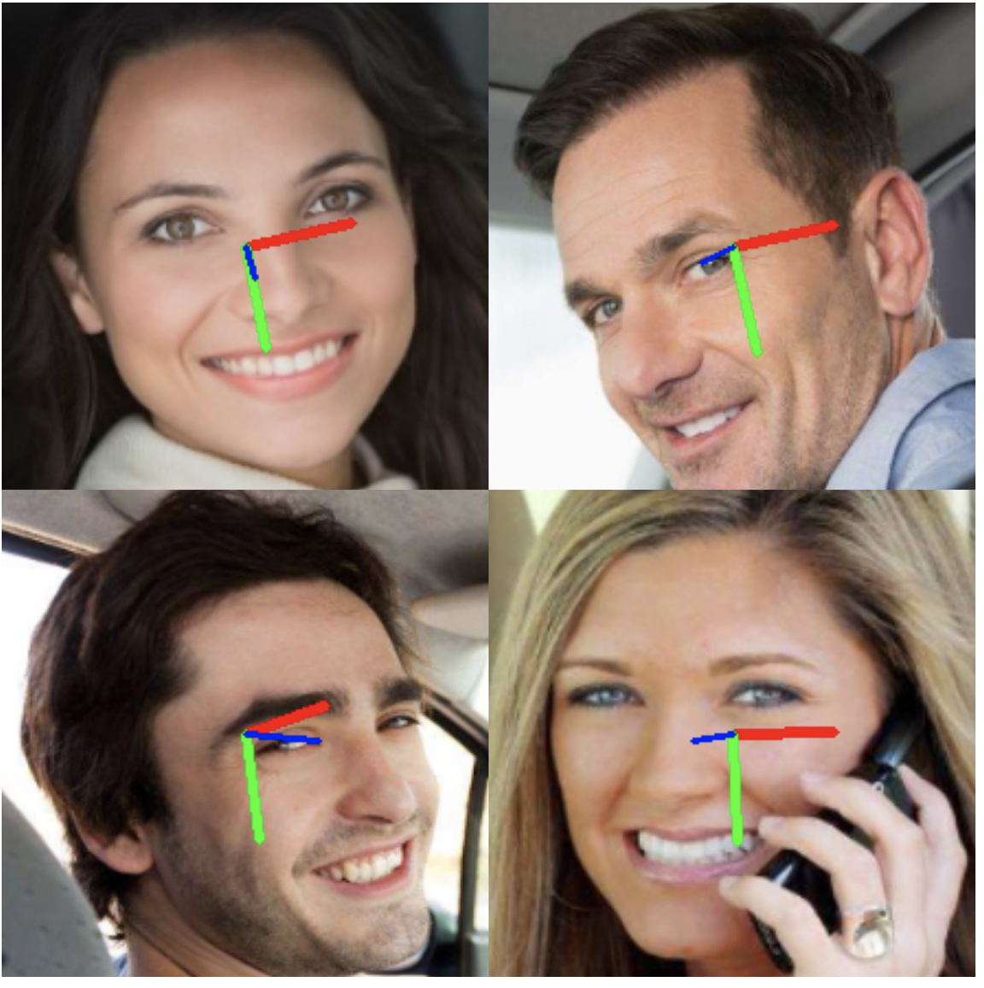
Pose Estimation
Yaw: ‘say no’
Pitch: ‘say yes’
Roll: ‘say maybe’

Slide 18
Landmarks

Slide 19
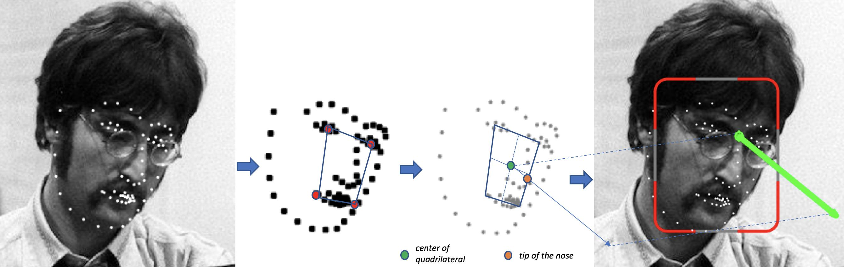
Pose from Landmarks

Slide 20
Location

Slide 21
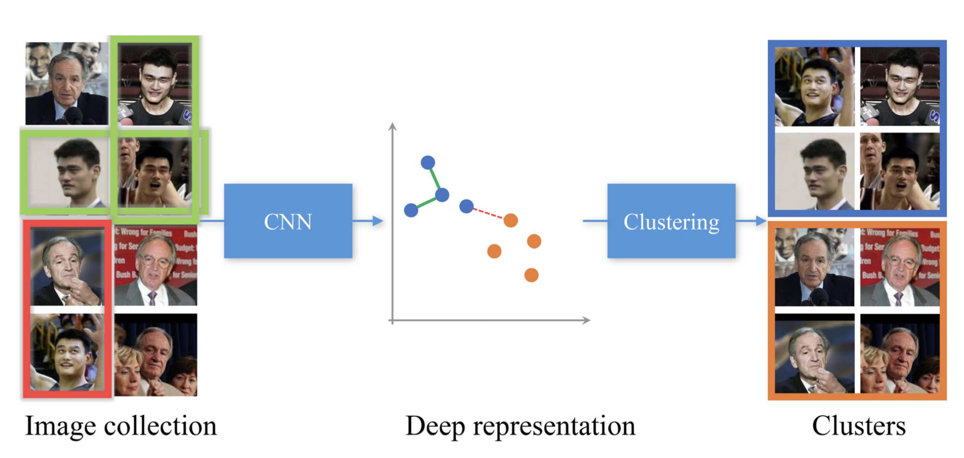
Face Clustering

Slide 22
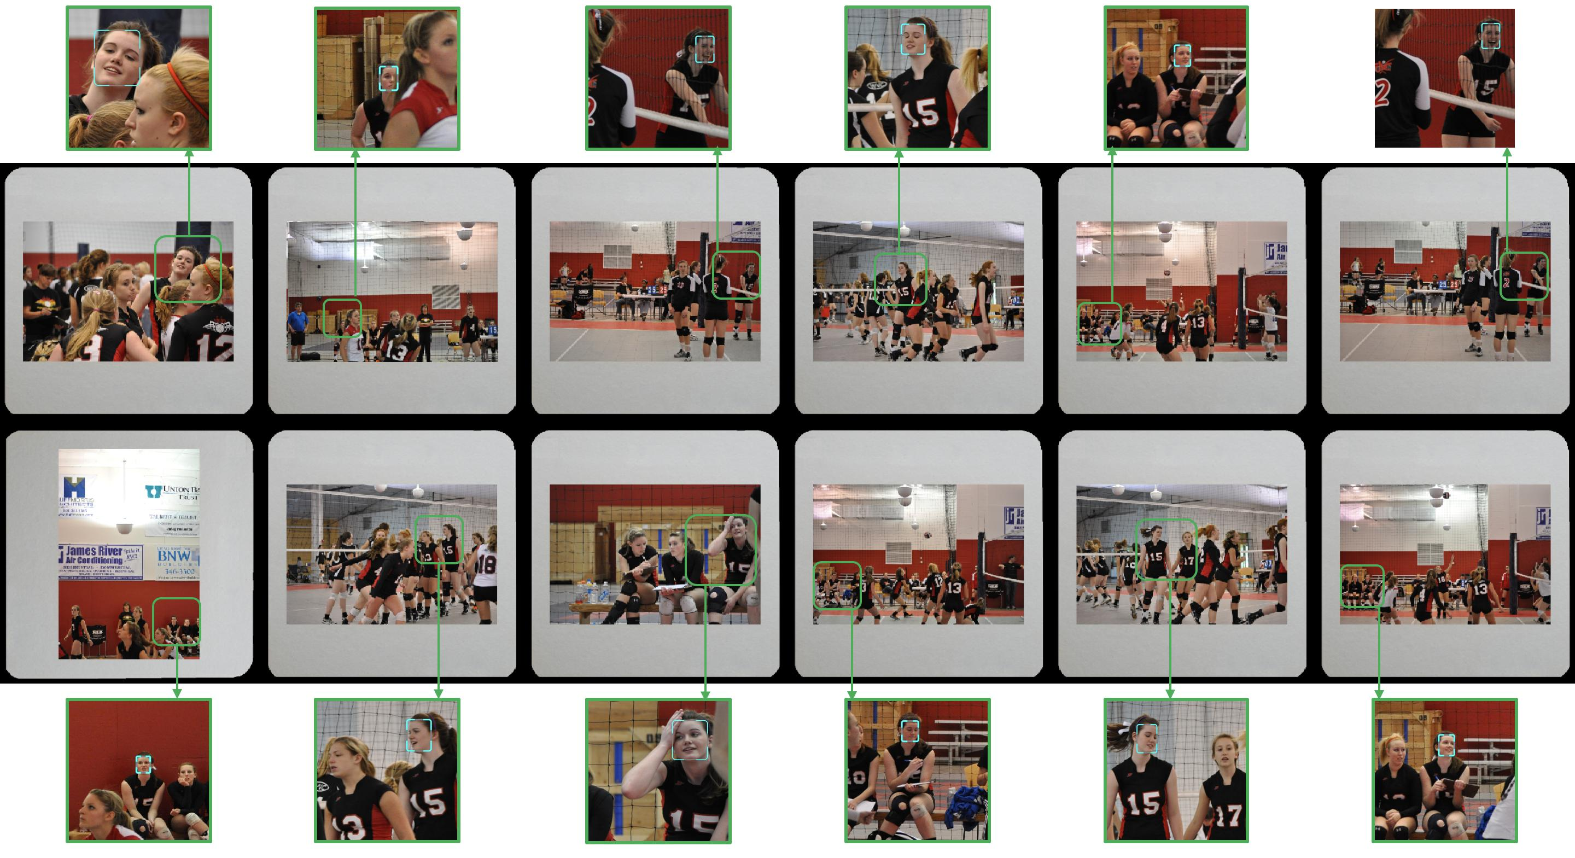
Face Clustering

Slide 23
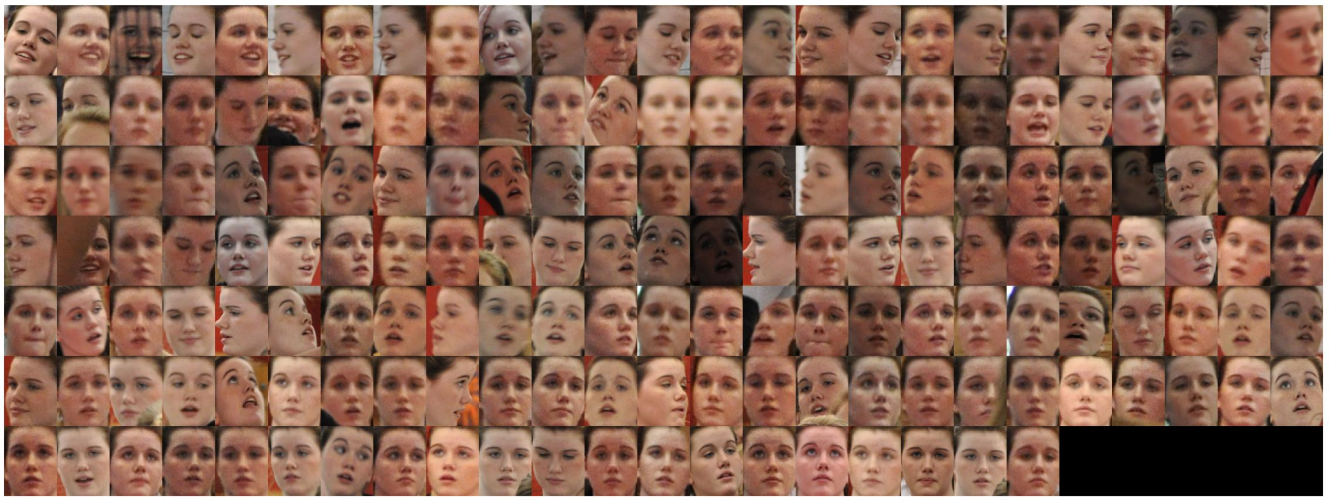
Face Clustering

Slide 24
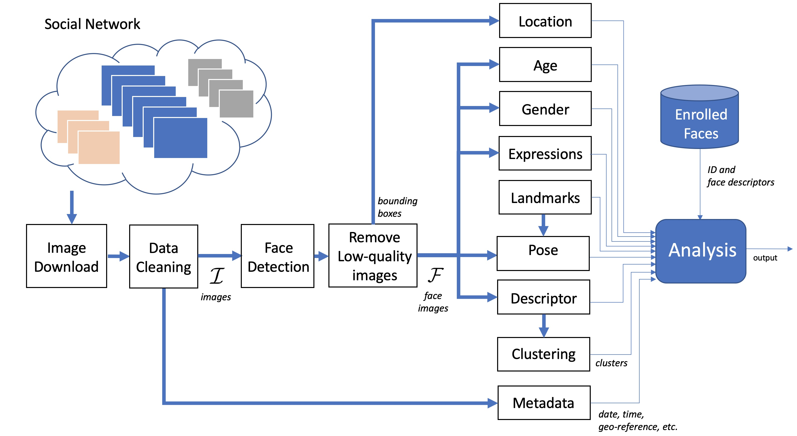

Slide 25
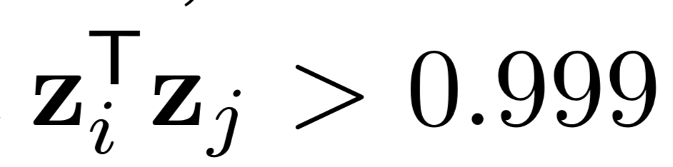
Data Cleaning
Remove duplicates
For each image k of the dataset
Convert to gray scale
Linear gray scaling: Min set to 0, Max to 255
Resize to 64x64 pixels (using bicubic interpolation)
Build 64x64=4096 vector with uni-norm z_{k}
Duplicates are those that

Slide 26
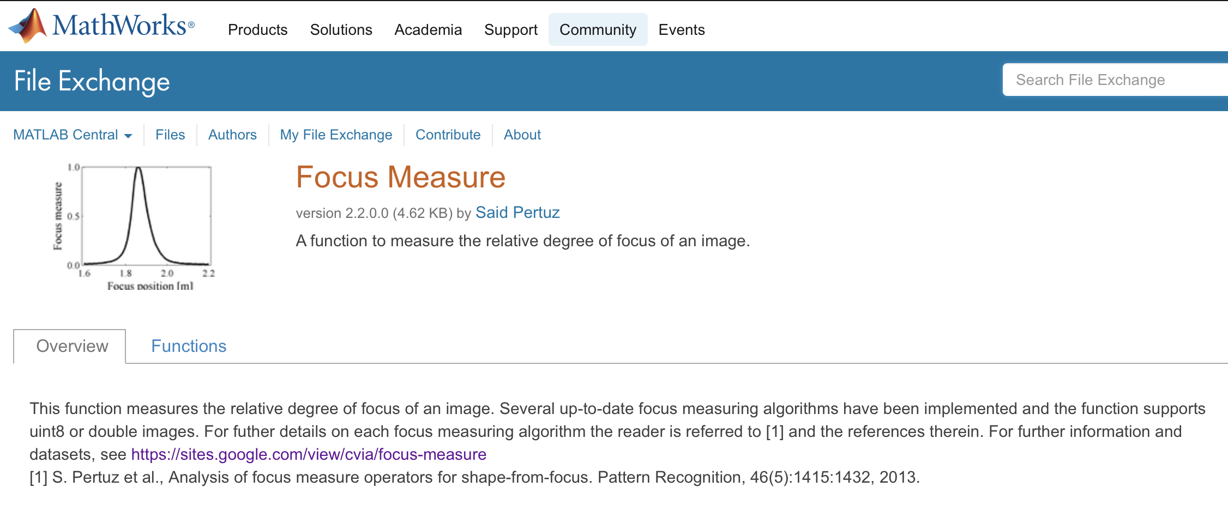
Data Cleaning
Remove low-quality face images
Remove very small face image < 25x25 pixels
Remove blur face images
Implementation
in Matlab

Slide 27

Co-occurrence
Images in which two persons are present

Slide 28
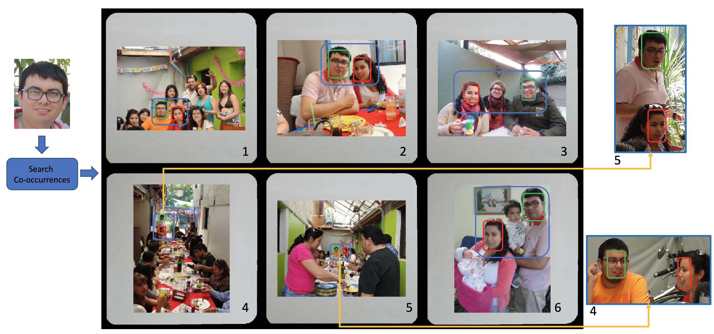
Co-occurrence

Slide 29
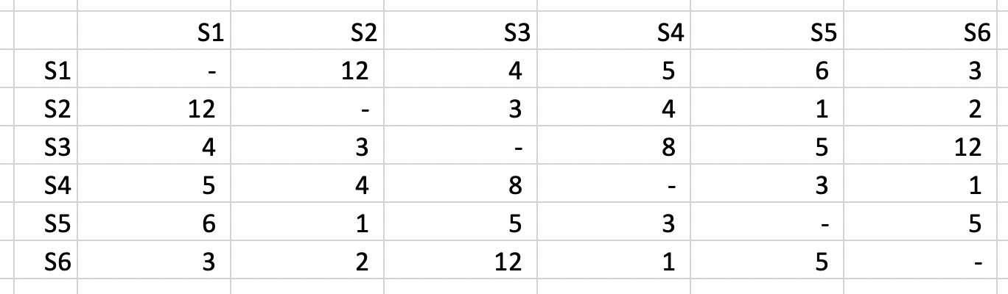
Co-occurrence
Images in which two persons are present
Co-occurrence Matrix for 6 subjects
Subjects 1 and 2 are present in 12 pictures

Slide 30
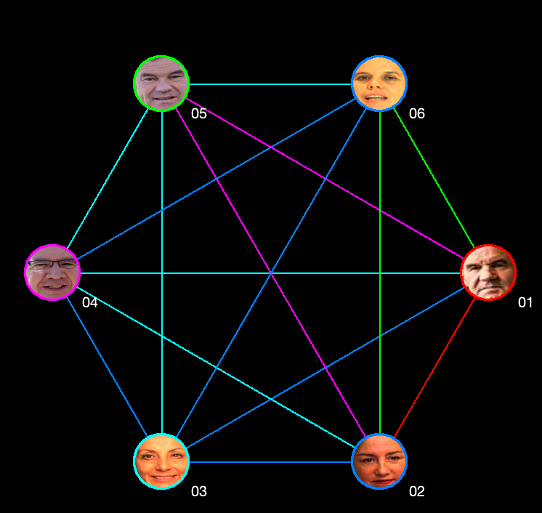
Co-occurrence

Slide 31
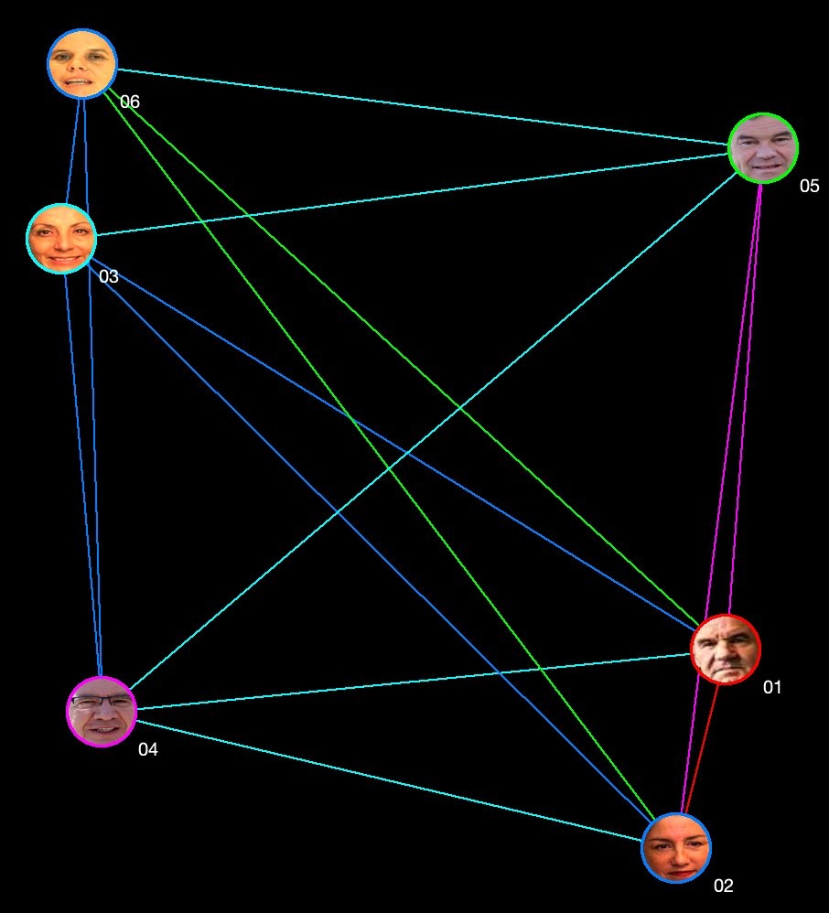
Co-occurrence
New representation:
Closeness mean more co-occurrence

Slide 32
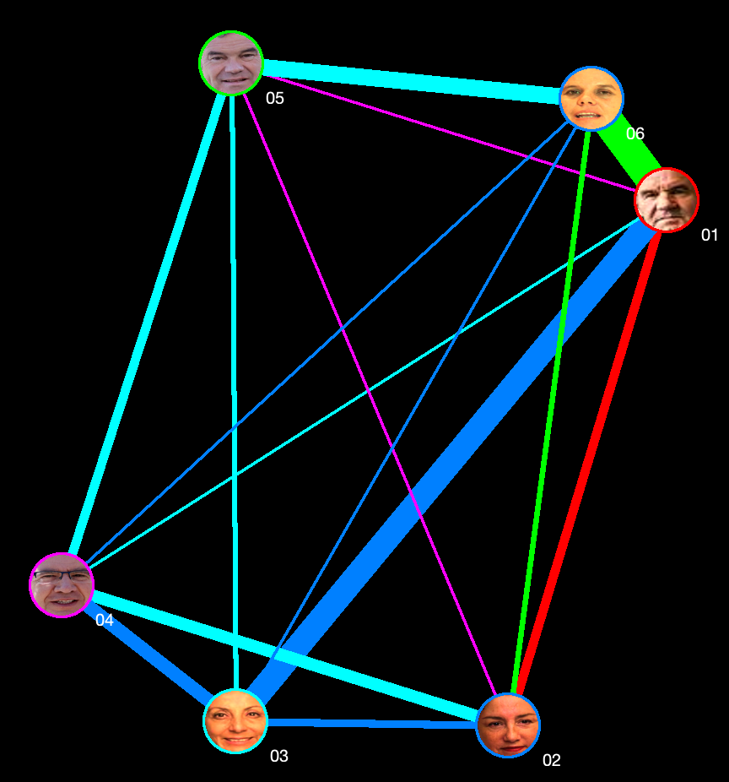
Graph Representation
Ideas for more representations
In this representations we could choose
Length of connections
Color of connections
Width of connections
Size of each face
Boundary color of each face
For example:
Color of connection could be related to facial expression
Width of connection related to co-occurrence
Length of connection related to distance in pixels

Slide 33
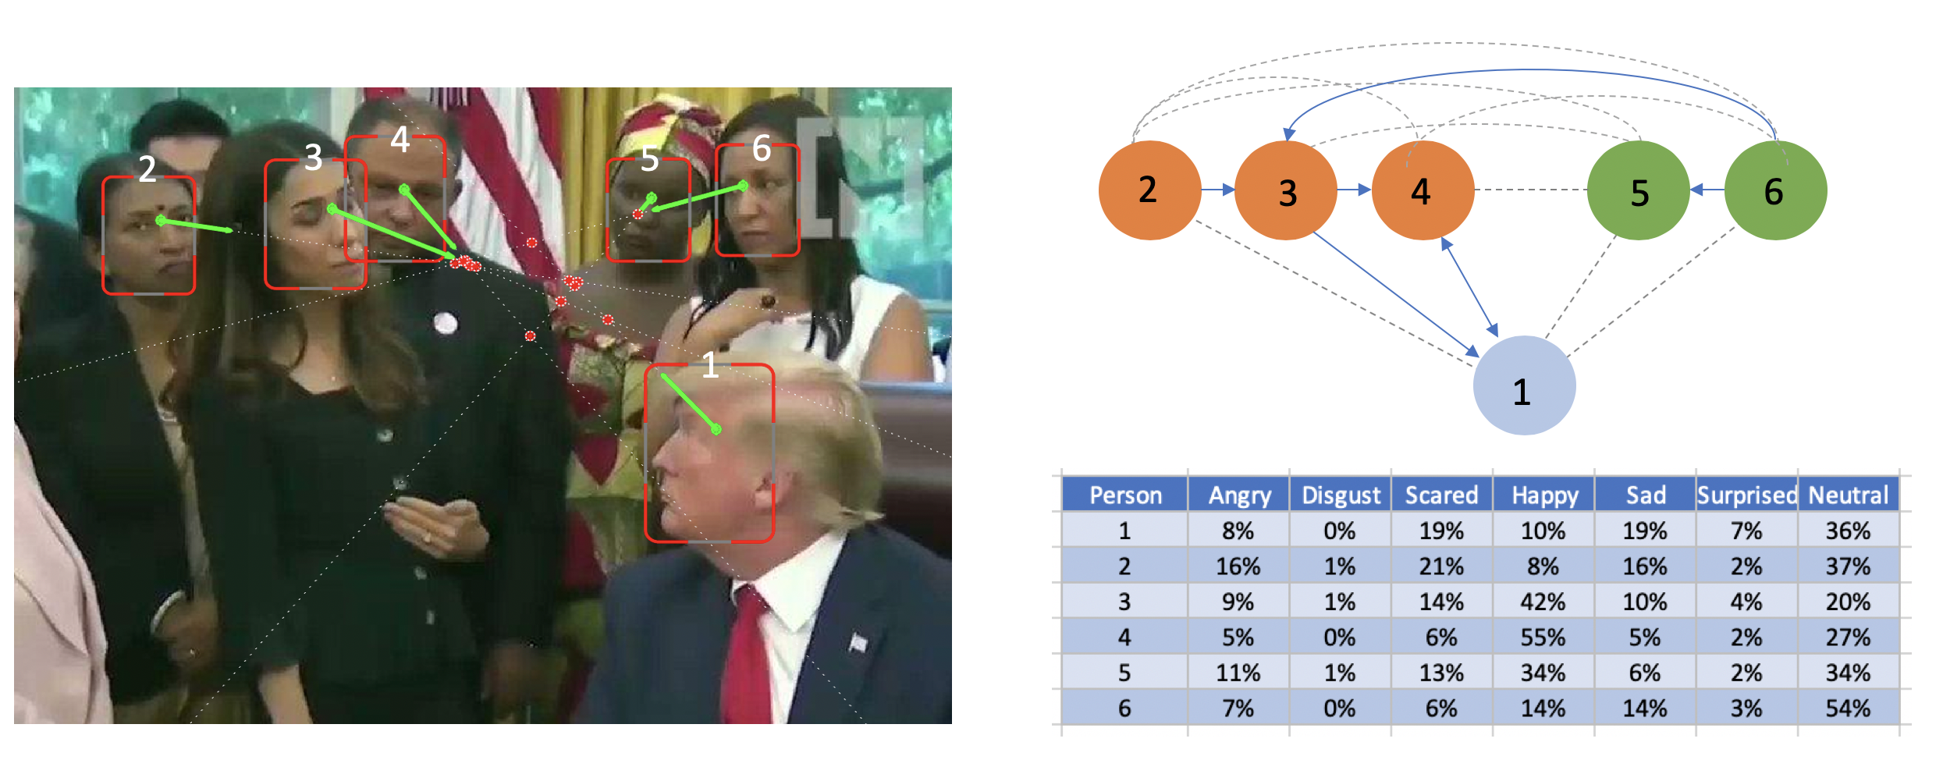
Interactions

Slide 34
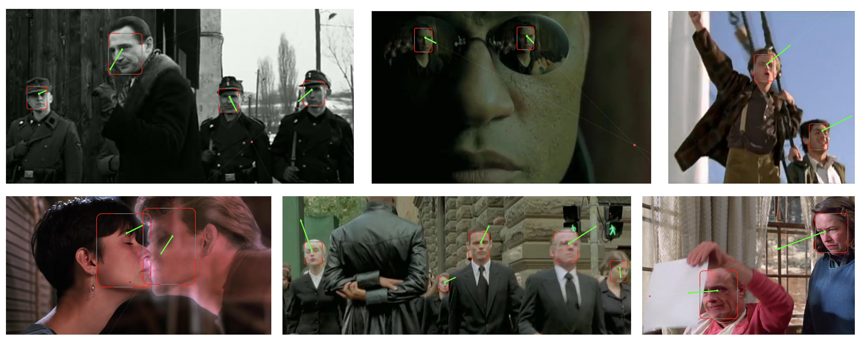
Interactions

Slide 35
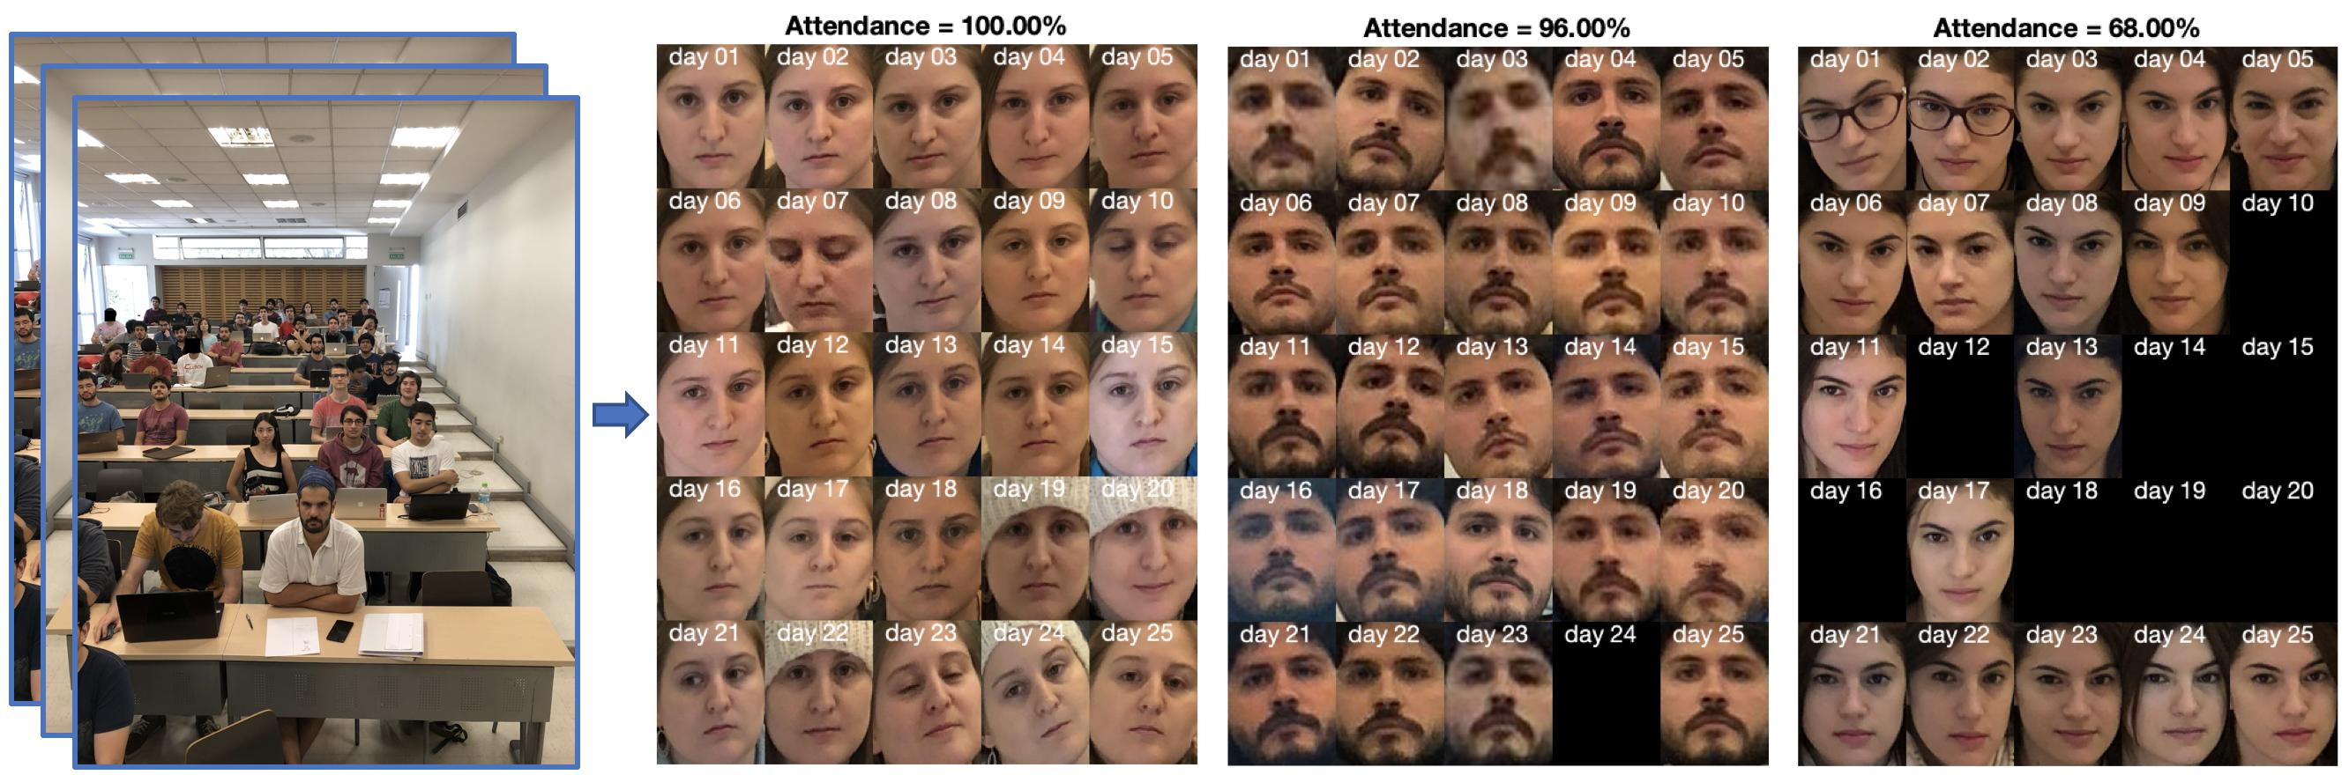
Using of Metadata

Slide 36
References
On July 9th, 2019, we downloaded images from Twitter given the hashtags #TheBeatles and #Beatles, and from the accounts @TheBeatles and @BeatleHeadlines. In these images, we can observe many pictures of the famous English rock band `The Beatles' and its members (Paul McCartney, John Lennon, George Harrison and Ringo Starr) in many poses, facial expressions and with different ages. This dataset has 1266 images, 452 were removed because they were duplicated, and 2228 faces were detected.
On July 19th, 2019, we downloaded images from Twitter given the hashtags #Trump and #DonaldTrump. In those days, Trump suggested on Twitter that the legislators that ``originally came from countries whose governments are a complete and total catastrophe'' should ``go back'' to those ``totally broken and crime infested places’ (see https://time.com/5630316/trump-tweets-ilhan-omar-racist-conspiracies/. In the downloaded images, we can observe many reactions for and against the four mentioned Democratic congresswomen. This dataset has 494 images, 126 were removed because they were duplicated, and 677 faces were detected.
On July 18th, 2019, we downloaded from Flickr twelve different family albums of pictures taken by Sandra Donoso (username sandrli -https://www.flickr.com/photos/sandreli/albums. The pictures are licensed under a Creative Commons ``Attribution-NonCommercial-NoDerivs 2.0 Generic''. In these pictures, we can observe the members of the family in celebrations and visiting vacation places in the last 5 years. This dataset has 1478 images, and 2838 faces were detected.
On July 2nd, 2019, we downloaded from Flickr the album ``VBVBA RVC 2 2010'' of pictures taken by Bruce A Stockwell username bas68) https://www.flickr.com/photos/bas68/albums/72157624234584197. The pictures are licensed under a Creative Commons ``Attribution-NonCommercial-NoDerivs 2.0 Generic''. In these pictures, we observe pictures of different volleyball games played on April 2010 by teenage players. This dataset has 1131 images, and 4550 faces were detected.
We downloaded the summaries done by WatchMojo.com of the ``Top 10 Most Memorable Movies of 199'' and the``Top 10 Movies of the 1990s'' (12 minutes each) https://youtu.be/5GvBPtlb-Ms https://youtu.be/dA-KcQ5BzUw and took one frame per second to build the set of images. In these images, we can observe movies like `Matrix', `Schindler List', `Pulp Fiction', `Ghost',etc. This dataset has 1492 images, and 1449 faces were detected.
A dataset for student attendance system in crowded classrooms was built in \cite{mery2019student} with pictures taken in 25 sessions. The dataset contains pictures of a classroom with around 70 students\footnote{\tiny{https://github.com/mackenney/attendance-system-wacv19}.}. In each dataset, approx. 6 pictures have been taken per session. Very useful for this dataset is the metadata of the dates on which each picture was taken. With this information, it is possible to establish the attendance record of each student previously enrolled (an enrolled face image is available for all students). This dataset has 153 images, and 5805 faces were detected.

